Slide 1

Caladan 2021 Covid-19 Preparation Plan

Slide 2
Roles
Project Lead- Nicholas Meeks
Project Managers- Carol and Lamese
Data Analysts- Jason and William
Data Engineers/Developers – Dom and Ryan

Slide 3
Problem Statement
Caladan has not been affected by Covid-19 so we have been tasked to determine what are the two most effective policies in curbing the spread of Covid-19.

Slide 4





Visualizations
Full School Closing
No Income Support
Number of Land Borders
Healthcare Investment
Average Temperature

Slide 5
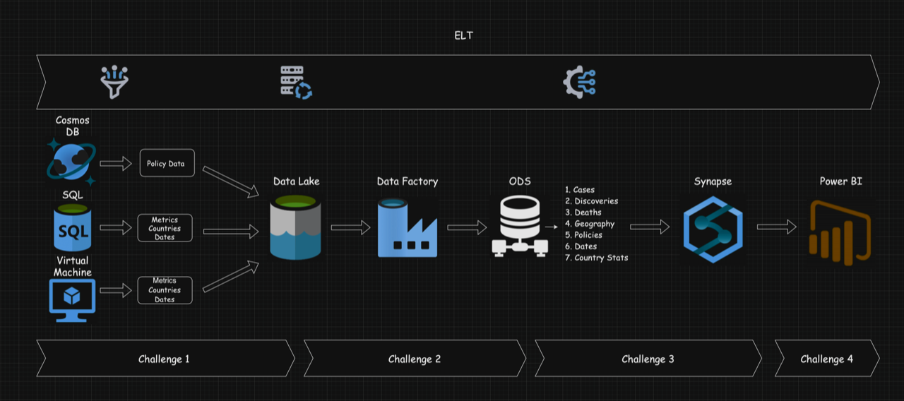
Data Architecture For Reliability
Notes:
Discuss the steps of this. Why this process is important. How we upheld the authenticity and reliability of the data through proper cleaning and organizing to promote true data and prevent leaks ( we abided by standard and made sure all data is processed through)

Slide 6
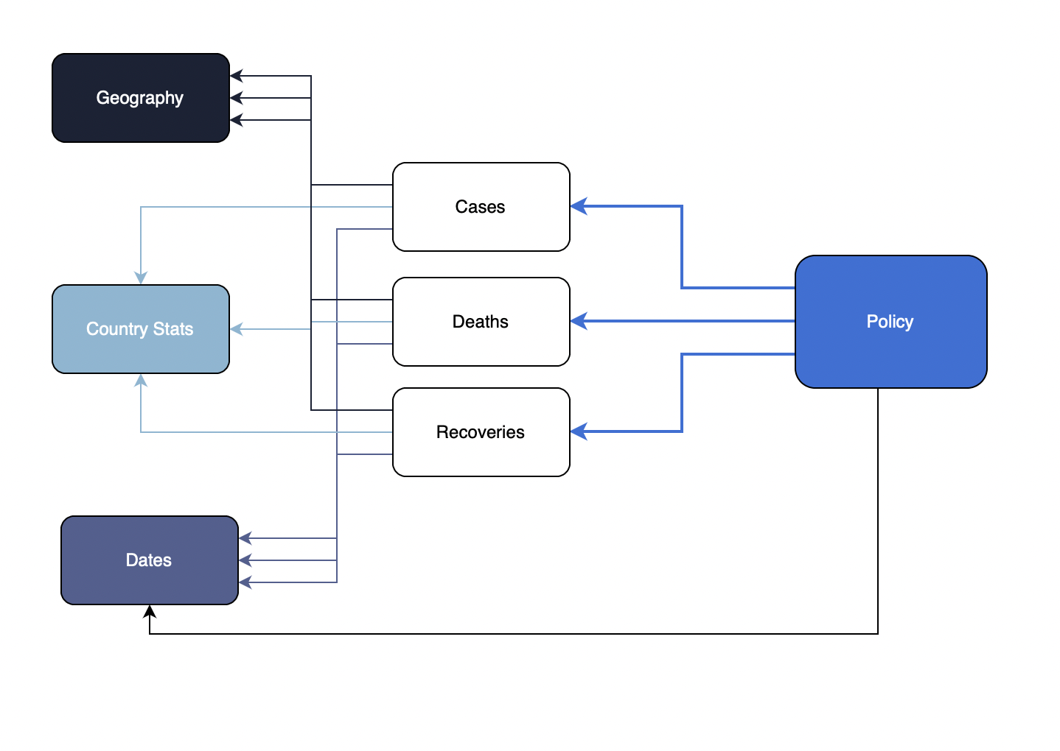
Schema Breakdown

Slide 7
Thank You!
Special thanks to Professor Seferlis and our project leader Shubham

